Slide 1

HR Compensation
Brent Bogan

Slide 2
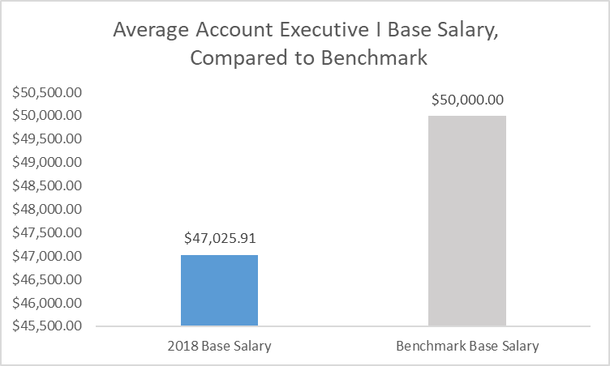
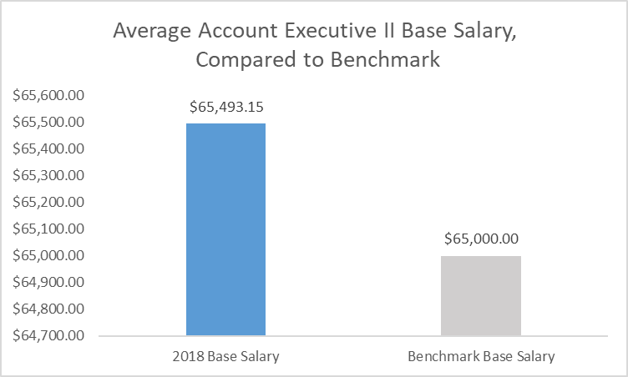

Base Salary

Slide 3
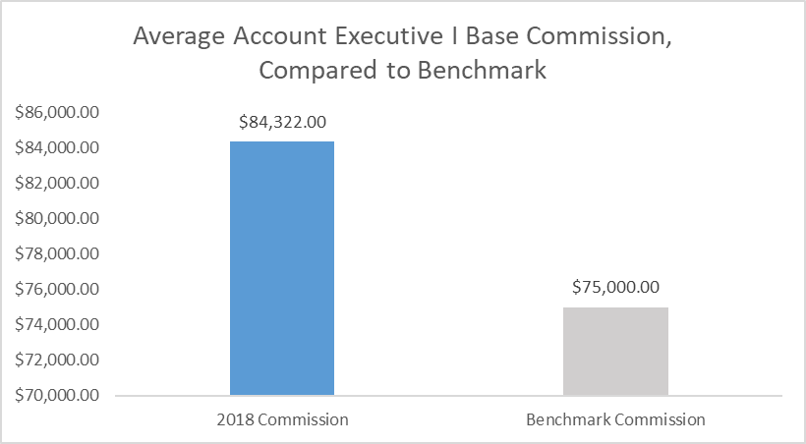
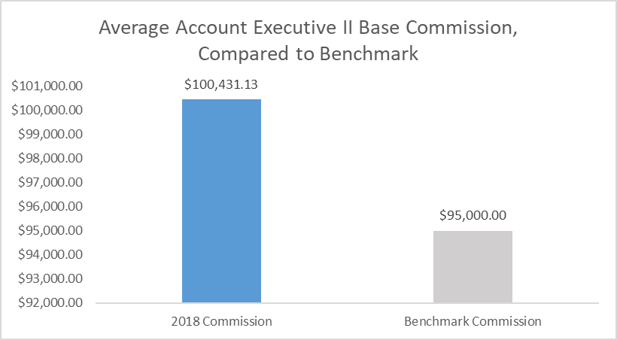

Base Commission

Slide 4
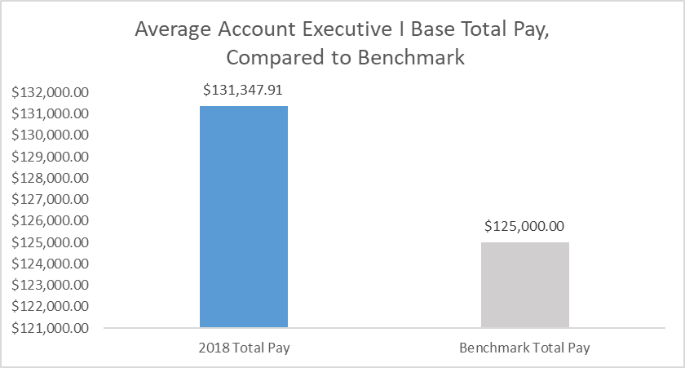
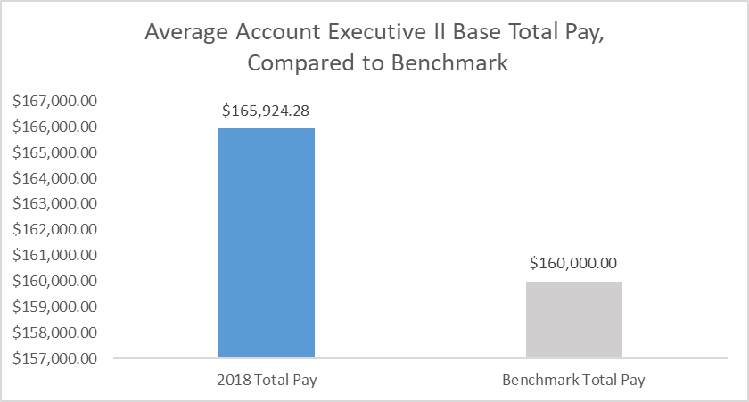
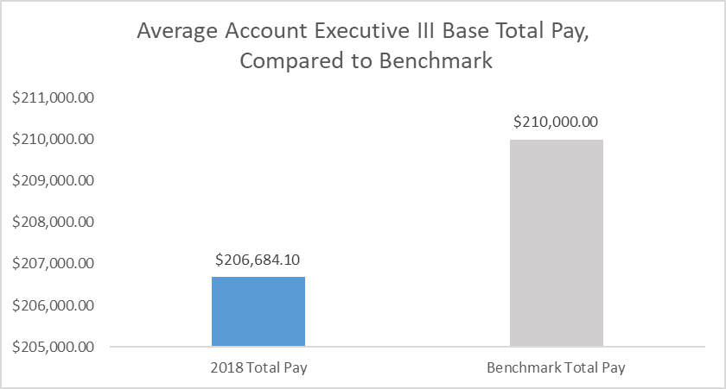
Total Pay

Slide 5
Analysis
Account Executive I makes $3000 less on average than the benchmark
Both salary and commission lower on average than benchmark
Account Executives II & III make $6000 more on average than the benchmark
Account Executive II’s commission is 5x than that of Account Executive III on average
Account Executive III’s salary significantly higher than benchmark

Slide 6
Recommendations
Increase base salary for Account Executive I
Add incentives for higher commissions
Add high commission totals for Account Executive II to stabilize high levels of activity
Increase base salary depending on individual performance for incentive
Increase commission rate incentives for Account Executive III

Slide 7
Conclusion
Compared base salaries, commissions, and totals versus benchmarks
Comparison analysis of each level of Account Executive
Suggestions for how to increase profitability based on analysis

